Slide 1


Slide 2
CHOOSE THE CORRECT ANSWER AND FILL IN THE BLANK
Meats are considered to be good sources of
2) Protein is made of
3) Protein is primarily needed to build parts of your body like skin and muscle.
TRUE- FALSE
4) All amino acids in our bodies come from food
TRUE- FALSE

Slide 3
5) Which Foods are good sources for protein?
a) Bread
b) Meat, Fish, eggs, greek yogurt, broccoli
c) Popcorn
d) Fruit juices

Slide 4
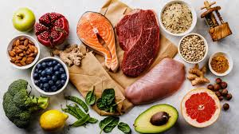
6) Protein is necessary for:
a) making hormones, enzymes and antibodies
b) maintaining fluid balance
c) clotting of blood
d) transporting oxygen
e) all of the above

Slide 5

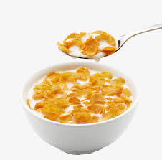
7) For breakfast you want to have a bowl of cereal (with no marshmallows or anything) with milk. What two groups are these in?
a) grain and dairy
b) grain and fruit
c) protein and dairy
d) fruit and protein

Slide 6
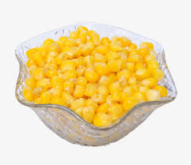
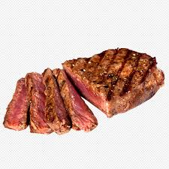
8) For dinner, you have a steak and sweetcorn. What two groups do these go in?
a) grain and fruit
b) both protein
c) protein and vegetables
d) fruit and sweets

Slide 7
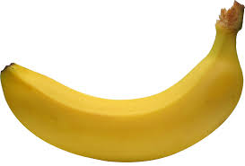
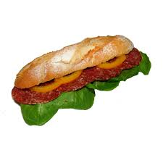
9) For lunch you have a sandwich with salami and an apple. What three groups do these belong to?
a) grain, vegetables, dairy
b) grain, protein, fruit
c) protein, sweets, vegetables
d) fruit, vegetables, sweets

Slide 8
10) There are amino acids that make up every type of protein.
11) Egg is the best source of protein
TRUE- FALSE
12) We need to provide essential amino acids from foods.
TRUE- FALSE

Slide 9

ANSWERS
Protein 8) C
Aminoacids 9) B
True 10) 20
False 11) True
B 12) True
E
A

