Slide 1


Slide 2
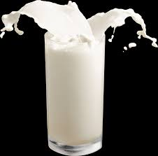
1) Which of the following is lowest in fat? (Circle one)
a) 2% milk
b)Whole milk
c) Skim milk
d) Low-fat milk

Slide 3
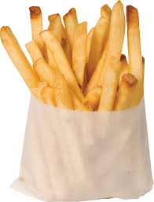
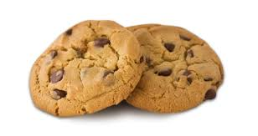
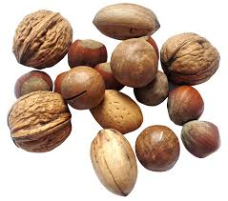
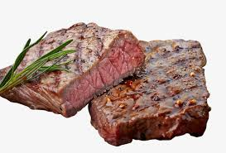
2) Which of the following foods contains the healthiest fat?
a) Nuts
b)Beef
c) Cookies
d) French fries

Slide 4
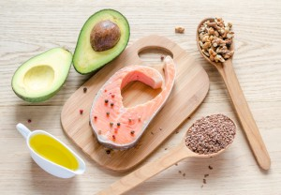
3) Unsaturated fats are often called ‘ healthy fats’ as they help reduce heart disease.
TRUE – FALSE
4) Unsaturated fats are solid at room temperature
TRUE- FALSE
5) Avocado is rich in fatty acids.
TRUE- FALSE

Slide 5
6) Where possible, bake, roast or steam food instead of frying can increase the intake of saturated fat.
TRUE- FALSE
7) High fat snack foods such as cakes, pastries, biscuits and chips reduce saturated fat intake.
TRUE- FALSE
8) Healthy fat also benefit your brains, improving memory and lifting mood.
TRUE- FALSE
9) Some types of fat are better for you than others.
TRUE- FALSE

Slide 6
10) The following are good sources of healthy fat?
a) French fries
b) Whole grain bread
c) Beans
d) Fish
11) A reduced-fat muffin is always a healthier choice than a regular muffin
TRUE- FALSE

Slide 7
ANSWERS
C 9) True
A 10) D
True 11) True
False
True
False
True
True

