Slide 2
CHOOSE THE CORRECT ANSWER
Fiber is digested in the small intestine
TRUE- FALSE
2) Vegetables and fruits are sources of fiber
TRUE- FALSE
Fruit and vegetables are more healthier than their juices
TRUE- FALSE
4) 12 gram fiber intake are recommended for your health
TRUE- FALSE
5) Low intake of fiber can cause constipation
TRUE- FALSE

Slide 3
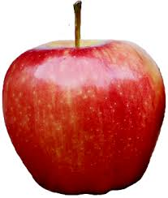
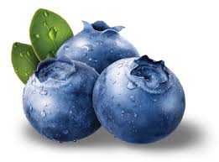
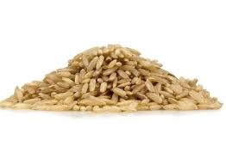
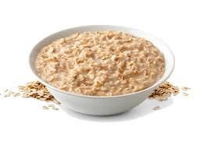
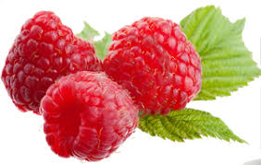
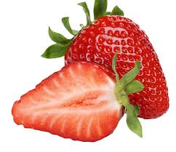
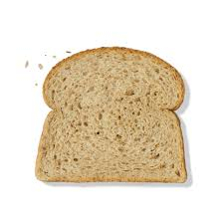
6) Which of these contains the most fiber?
a) Apple, 1 medium with skin
b) Blueberries, 1 cup
c) Brown rice, 1 cup
d) Oatmeal, 1 cup
e) Raspberries, 1 cup
f) Strawberries, 1 cup
g) Whole wheat bread, 1 slice

Slide 4
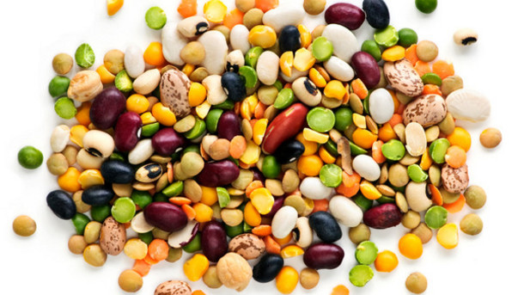
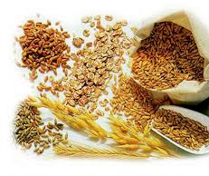
7) Good sources of fiber include:
a) Whole grains
b) Legumes
c) Both of the above
d) Neither of the above

Slide 5
8) Carrots are good for your hearing.
TRUE- FALSE
9) Garlic and onions kill flu and cold viruses.
TRUE- FALSE
10) Blueberries fight the bacteria that cause ear infections.
TRUE- FALSE
11) Spinach is good for your spirits because it contains a lot of calcium.
TRUE- FALSE

Slide 6
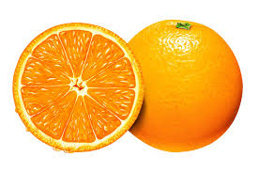
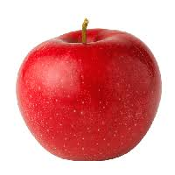
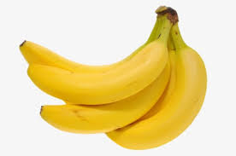
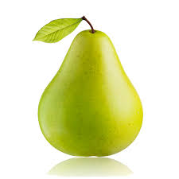
12) Which fruit is highest in vitamin C?
a)
b)
c)
d)

Slide 7
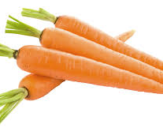
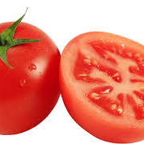
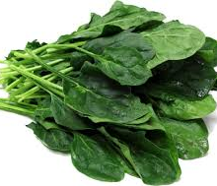
13) Lycopene is an antioxidant in tomatoes, carrots and spinach, protects us from what?
A) Heart disease
B) Sun damage
C) Cancer
D) All of the above

Slide 8
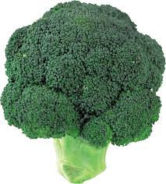
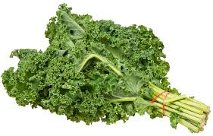
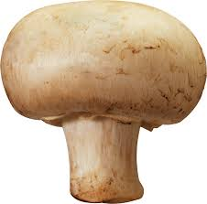
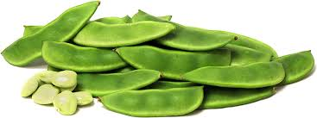
14) Which veggie provides the most protein per calorie?
A) Broccoli
B) Kale
C) Mushrooms
D) Lima beans

Slide 9
ANSWERS
False 8) False
True 9) True
True 10) False
False 11) False
True 12) A
E 13) D
C 14) C

