Slide 1
LUNCH BOX

Slide 2
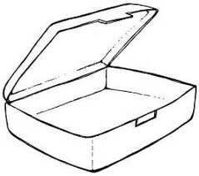
Draw the food items in your healthy lunch box

Slide 3
Explain why did you choose these food items in your healthy lunch box
Why these food items are necessary for your health?

