Slide 1
HEALTHY FOOD SWAP

Slide 2
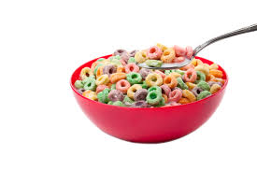
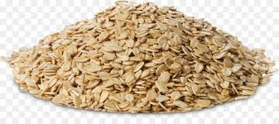
Whole grain cereal instead of Sugary cereal

Slide 3
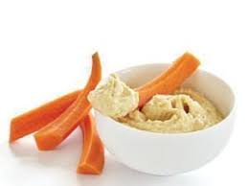
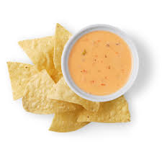
2) Carrot and hummus snack instead of Chips and dip

Slide 4
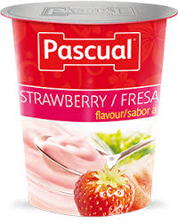
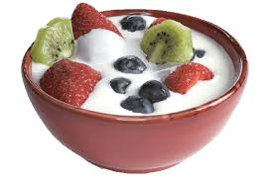
3) Plain yogurt with fruits instead of flavoured yogurt

Slide 5
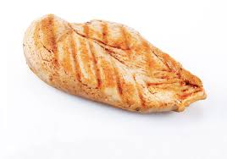
4) Chicken breast instead of chicken nuggets

Slide 6
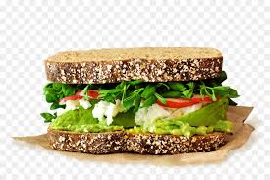
5) Whole grain sandwich with eggs instead of hot dogs

Slide 7
6) Water instead of fizzy drinks

Slide 8
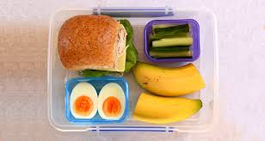
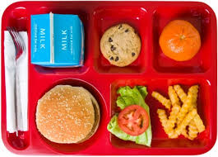
7) Healty lunch box instead of unhealthy lunch box

