Slide 1
DID YOU KNOW

Slide 2
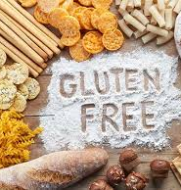
Type of gluten-free diet may be higher in calories, since many processed gluten-free foods contain higher levels of fat and/or sugar to compensate for flavour and texture changes which result from the removal of gluten.
Gluten free diet may lead to reduced fiber intake in your diet and may increase the risk of heart disease

Slide 3
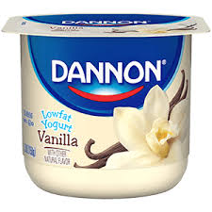
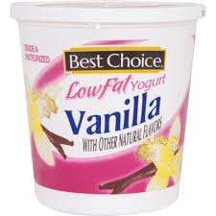
3) Some low-fat yogurt contains added sugar or flavourings that can make it a less healthy option than plain yogurt.
4)Adding fresh fruit to plain yogurt is generally a better option than eating yogurt with added fruit plus sweeteners.
5) Flavoured yogurt is higher in calories. For example, a single 150-gram serving of Strawberry yogurt provides 15 grams of sugar and 140 calories.
6) Frozen yogurt often contains more sugar and less protein than the type of yogurt that you keep in the refrigerator.

Slide 4
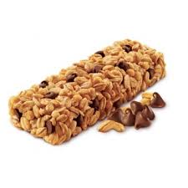
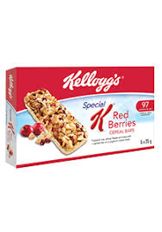
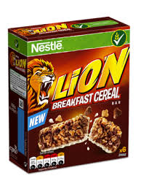
7) Most cereal bars have a high calorie and low nutritive values.
8) Some cereal bars contain low fiber and much sugar
9) Some cereal bars contain high in saturated fat
10) When compared to other cereal bars, it may be a good option to consume a bowl of oatmeal, muesli or low-sugared cereal with low-fat milk.

Slide 5
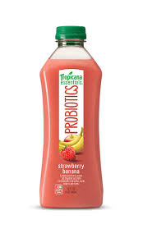
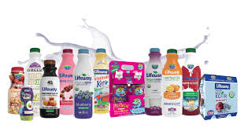
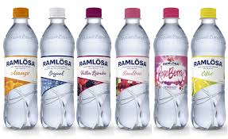
11) Not all probiotic products are effective. A drink needs to contain at least a billion probiotic bacteria to be effective.
12) All low fat products may contain unhealthy ingredients.
13) Flavoured water should be consumed less to prevent damage to teeth
14) Some flavoured water contain unhealthy ingredients.

Slide 6
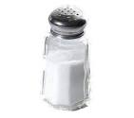
15) We don’t need to eat extra salt because foods such as meat, cereals, vegetables, fruits and dairy products meet the requirements of sodium.
16) If we eat too much bread and breakfast cereals, we consume a lot of salt in our diet.
17) Daily recommended salt consumption for aged 1 to 3 years 2gram
18) Daily recommended salt consumption for aged 4 to 6 years 3gram.
19) Daily recommended salt consumption for aged 7 to 10 years 5gram

Slide 7
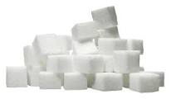
20) Food companies often use unusual names for sugar to show less sugary products.
21) Sugar is also added to foods in the form of syrups. Syrups are usually thick liquids made from large quantities of sugar dissolved in water.

